Slide 1
Sonar Propagation Modeling in Spherical-Time Coordinates Theory and Implementation
Mr. Sean Reilly
University of Rhode Island
Ocean Engineering Department
August 2011

Slide 2
Acknowledgements
Work at the University of Rhode Island supported by Dr. James Miller and Dr. Gopu Potty.
Efforts to test and productize this model have been funded by Alion Science and Technology, Inc. (IRaD) and U.S. Office of Naval Research (HiFAST).
Special thanks to Dr. Michael Goodrich (Alion) who developed the 3-D slope reflection and made significant contributions during testing.
Special thanks also to Dr. Roy Deavenport who convinced me to start working on this in 1994.

Slide 3
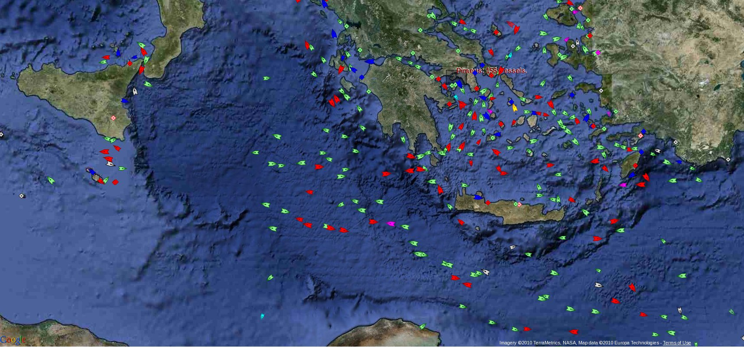
Motivation ⇨ TASW Training
AIS merchant ship traffic report from MarineTraffic.com on 02-16-10
Italy
Greece
Turkey
zoom-in
Typical Theater ASW exercise requires littoral ocean TL calculations at rate of 1500 target/sensor pairs per minute, in real-time, across operating area.

Slide 4
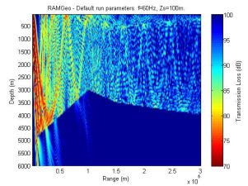
Many Models are 2-DxN
AIS merchant ship traffic report from MarineTraffic.com on 02-16-10
Extract radial and compute TL
TL image from http://cmst.curtin.edu.au/products/actoolbox/
TL calculations done in a simple (x,y) system.
But, radial extraction has its own accuracy losses and CPU costs.

Slide 5
Objectives
Create a much faster TL model for real-time, littoral, active sonar sim/stims by revisiting fundamental assumptions of ray theory.
Speed goals:
100 targets for one sensor
Update rates faster that the speed of sound
On a single core of an average laptop
Insignificant loss in accuracy at MF and HF freqs.
Then, once we have a fast algorithm, expand to additional sensors using better hardware.

Slide 6
Approach
3-D spherical coordinates (lat, long, alt)
Avoids translation of environmental data into 2-DxN.
Time domain ray trace
Improves continuity of wavefront with fewer rays.
Works best at mid and high frequencies.
Hybrid Gaussian beams
Improves performance in shadow zones and at lower frequencies.
Test using publicly available databases.
Add proprietary and Navy database later as extensions of class hierarchy.

Slide 7
Theory
The math behind the model

Slide 8
Relationship to Wave Theory
Look for solutions in the form:
Match powers of ω:
O(ω²) :
O(ω) :
O(ω^{1-n}) :
(eikonal)
(transport)
(diffraction)

Slide 9
Rays Characterize Wavefronts
eikonal
characteristic paths of the rays
transport
spreading loss proportional to ray divergence
diffraction
small if “c” changes slowly over λ.
Ray theory plugs this into eikonal.

Slide 10
Rays in Time Domain
1) eikonal
2) use rays along paths
3) use
typical ray model
4) use
this model
Coupled vector ODEs in 3-D
Solved using initial conditions & marching solution

Slide 11
Rays in Spherical Coordinates
Earth’s axis
area of operations
altitude = h
r = R + h
R
center of
latitude
= π/2-θ
equator
the earth
center of
curvature
longitude = φ
use WGS-84 ellipsoid, but assume uniform curvature over area of operations

Slide 12
Adams-Bashforth 3 Integrator
Estimates next time step from explicit terms in previous three.
Implement as a cached circular queue of 4 wavefronts.
Single calculation of sound speed and derivative (slowest calculations) per iteration.
Single calculation of sin θ and cot θ per iteration.
As accurate and much faster than Runge-Kutta 3, but not self starting.
τ_{n-2}
τ_{n-1}
wavefront
τ_{n}
τ_{n+1}
τ_{n+2}

Slide 13
Ray Reflection from 3-D Slope
Computing point of impact
current
s
A
A
r
R
Computing reflection direction
I
next
“wrong side of interface”
= surface normal at reflection point
= incident ray direction
= reflected ray direction
= component of incident ⊥ to normal
= time delay until reflection
2nd order Taylor series used to
improve accuracy of incident
ray direction during reflection
Notes:
Double check the picture

Slide 14
Eigenray Offset Estimation
eigenrays = interpolation of ray features based on offset Δ
Taylor series on
CPA derivative
Side view
d = distance from target to wavefront point
Δ = offset vector from CPA in time, D/E, AZ
b = gradient of squared distance at CPA, and
A = Hessian matrix of squared distance at CPA.

Slide 15
Hybrid Gaussian Beam TL
Launch D/E
View across wavefront
Use spreading to estimate divergence instead of dynamic ray equations.
Form 2-D Gaussian beams that are centered between rays.
Time domain wavefront keeps contributions in phase.
μ
j+2
Gaussian
beam centers
μ
j+1
μ
j
Eigenray
Target
Peak α 1/width
μ
j
-
1
ϕ
ϕ
ϕ
ϕ
k
-
1
k
k+1
k+2
Launch AZ

Slide 16
Implementation
Focusing on speed, ease of integration, ease of extension.

Slide 17


Under Sea Modeling Lib (USML)
Gaussian Rays
Not fully tested.
Gaussian Beams and caustics need work.
Wave Fronts
Eigenray Results
ProplosS Results
acoustic
models
NetCDF Files
Fundamental Data Types
Ocean Components
Bathymetry
Ocean Profiles
COARDS, WOA, ETOPO
Data Grids
Sequences
World Coordinates
Profiles
Attenuation
Boundaries
Reflection Loss
modeling
framework
uBLAS Extensions
uses
abs, arg, sqrt, max, ...
cos, acos, cosh, acosh, ...
exp, log, pow, ...
Complete & tested.

Slide 18
Test Driven Development (TDD)
Start the development of each new feature by first designing its unit test.
Every module includes a “test” directory.
Detect and record failures to match analytic results.
Readiness of each new feature defined by the quality of its test.
Boost Test Library Unit Test Framework (UTF) to implement these goals.
Organizes unit tests into a regression suite.
Unit tests focus on verification phase of testing.
Prove that software works as designed,
not that model replicates real-world (validation).
That comes later.

Slide 19
uBLAS is our foundation
uBLAS is a widely used C++ matrix/vector library based on expression templates
Eliminates key obstacles to efficient numerical computing in C++, namely temporaries and virtual function calls.
Unwraps matrix/vector operations to avoid branching.
Significantly faster then Blitz++, POOMA, MTL.
ViennaCL extension implements uBLAS on GPUs.
USML adds basic features needed for scientific computing
scalar addition: matrix +/- scalar, scalar +/- matrix
division of scalar by matrix
max(), min(), floor(), ceil()
abs(), abs2(), arg(), sqrt(), copysign()
cos(), cosh(), sin(), sinh(), tan(), tanh()
acos(), acosh(), asin(), asinh(), atan(), atan2(), atanh()
exp(), log(), log10(), pow()
uniform, Gaussian, complex Gaussian random numbers
References:
T. Veldhuizen, "Expression Templates," C++ Report, Vol. 7 No. 5 June 1995, pp. 26-31
http://en.wikipedia.org/wiki/Expression_templates
http://www.boost.org/doc/libs/1_46_1/libs/numeric/ublas/doc/index.htm

Slide 20
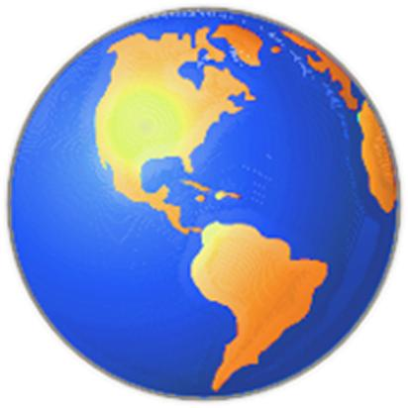
Fundamental Data Types
Self-Interpolating Data Grids
in N Dimensions
World Coordinates
wvector
matrix of
ρ, θ, φ
Nearest, Linear, PCHIP Interpolation
wposition
matrix of
latitudes
longitudes
altitudes
sequence 2
data
distance, dot, area, direction, earth radius
sequence 1

Slide 21
NetCDF Files
netcdf_coords
Extracts a data_grid by name from any netCDF file that complies with Cooperative Ocean/Atmosphere Research Data Service (COARDS) standards.
netcdf_bathy
Extracts a 2-D data_grid from a variety of netCDF formats.
Deduces the variables to be loaded based on their dimensionality.
netcdf_profile
Extracts a 3-D data_grid from a variety of netCDF formats.
Deduces the variables to be loaded based on their dimensionality.
netcdf_woa
netcdf_profile that splices shallow and deep World Ocean Atlas (WOA) databases.
Supports input from many publicly available databases.

Slide 22
Ocean Profiles & Attenuation
attenuation_constant
attenuation_thorp
future...
1
attenuation_model
each profile_model
is a kind of
attenuation_model
each profile_model
includes one
attenuation_model
profile_model
data_grid
profile_linear
profile_munk
profile_grid
future...
profile_n2
profile_catenary
Decorator Design Pattern
profile_mackenzie

Slide 23
attenuation_model methods
virtual void attenuation (
const wposition& location,
const seq_vector& frequencies,
const matrix< double >& distance,
matrix< vector< double > >* attenuation
)
Computes the broadband absorption loss
location = Matrix of locations at which to compute.
frequencies = Frequencies over which to compute loss.
distance = Distance travelled through the water.
attenuation = Absorption loss in dB at each location and frequency (output).

Slide 24
profile_model methods
virtual void sound_speed (
const wposition& location,
matrix< double >* speed,
wvector* gradient = NULL
)
Compute the speed of sound and 3-D derivatives
location = Matrix of locations at which to compute.
speed = Speed of sound (m/s) at each location (output).
gradient = Sound speed gradient at each location (optional output).

Slide 25
Ocean Boundaries & Reflection
reflect_loss_constant
reflect_loss_rayleigh
future...
1
reflect_loss_model
each boundary_model
is a kind of
reflect_loss_model
each boundary_model
includes one
reflect_loss_model
boundary_model
data_grid
boundary_flat
boundary_slope
boundary_grid
future...
Decorator Design Pattern

Slide 26
Ocean Model Container
profile_model
profile
ocean_model
surface
bottom
boundary_model
Combines the effects of surface, bottom,
and profile into a single model.

Slide 27
Wavefront Propagation
ocean_model
7) wave_front.step()
8) read
detect reflections
9) update
1) read
propagate
wavefront
3) update
next
current
proploss
targets
2) read
wave_element
circular queue
previous
4) read
past
detect eigenrays
5) read
6) add
proploss eigenrays

Slide 28
wave_element data
wposition position
wposition pos_gradient
wvector ndirection
wvector ndir_gradient
matrix<double> sound_speed
wvector sound_gradient
matrix< vector< double > > attenuation
matrix< vector< double > > phase
matrix<double> distance
matrix<int> surface
matrix<int> bottom
matrix<int> upper
matrix<int> lower
const wposition* targets
matrix< matrix<double> > distance2
ocean_model& _ocean
const seq_vector* _frequencies
wvector _dc_c
matrix<double> _c2_r
matrix<double> _sin_theta
matrix<double> _cot_theta
matrix<bool> _on_fold
Most matrices have NxM elements
N = number of D/E launch angles
M = number of AZ launch angles
Vectors for frequency dependence.
Pointers used to reference data across elements.
Cache private workspace for frequently used terms.
wave_front is circular queue of wave_elements.

Slide 29
proploss and eigenray data
proploss
const wposition* _targets
const seq_vector* _frequencies
const wposition1* _source_pos
const seq_vector *_source_de
const seq_vector *_source_az
double _time_step
matrix< eigenray_list > _eigenrays
matrix< eigenray > _loss
eigenray
const seq_vector* frequencies
vector< double > intensity
vector< double > phase
double source_de
double source_az
double target_de
double target_az
int surface
int bottom
int upper
int lower
eigenray_list
typedef std::list< eigenray > eigenray_list
_eigenrays = individual eigenrays for each target
_loss = coherent summation for each target (if computed)

Slide 30
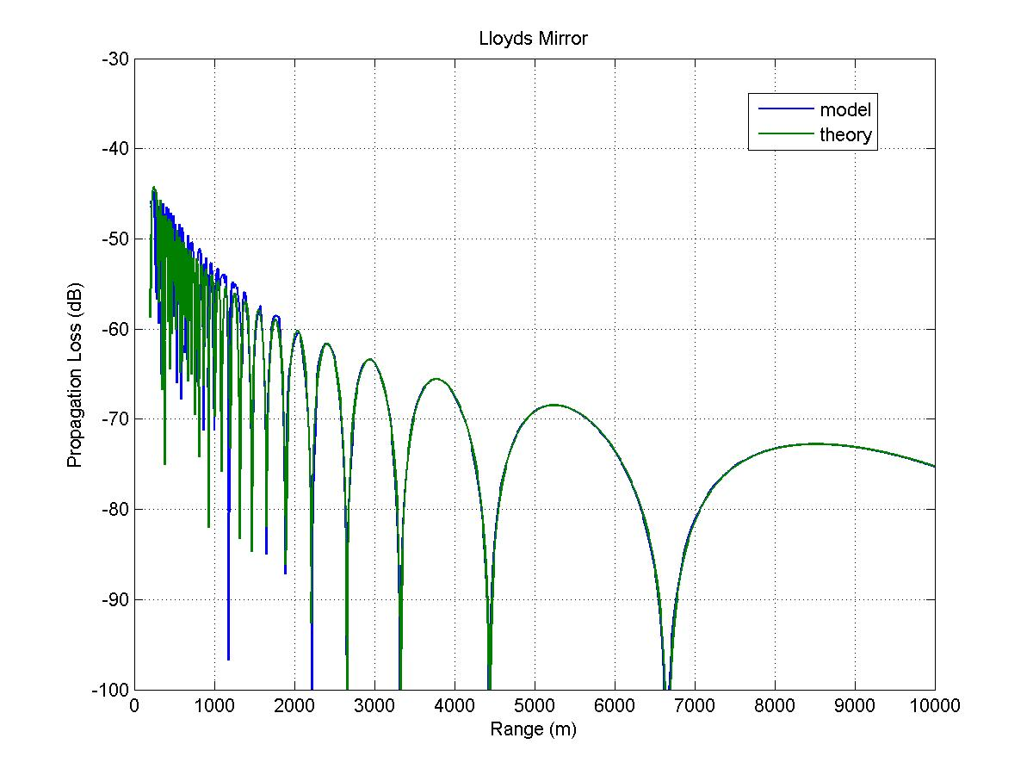
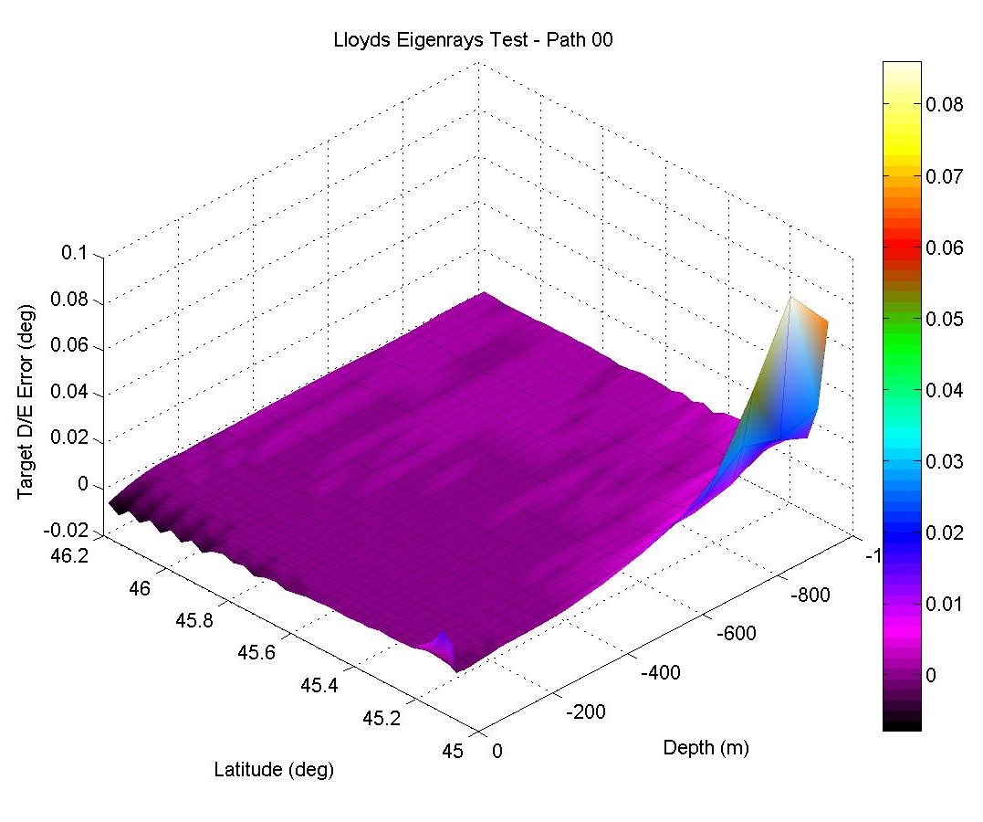
Eigenray Benchmark Testing
Compare to analytic solutions and industry classics such as ASA Wedge, Pedersen N² Linear, etc.
Requires SVP correction when compared to flat earth benchmarks.
Developing metrics and thresholds for quantitative analysis.
rms difference = 0.1148 dB
r^2 correlation = 87.07 %

Slide 31
TL Near Shadow Zone
Source Depth = 66.7 yds
Receiver Depth = 66.7 yds
Frequency = 2000 Hz
c₀ = 1677.3319 yd/sec
g₀ = 1.2286762 sec-1
ref: M. A. Pedersen, D. F. Gordon, "Normal-Mode and Ray Theory Applied to Underwater Acoustic conditions of Extreme Downward Refraction", J. Acoust. Soc. Am. 51 (1B), 323-368 (June 1972).

Slide 32
Speed Goals?
Can we create an active sonar TL model that is much faster than those currently used?
This hypothesis is still un-proven.
The ray propagator is very fast, but the eigenray estimator is pretty slow.
Fortunately, this effect is minimized if # targets is small (hundreds), and this is true in sim/stims.
This model won’t be good for all applications, but hopefully it will be much better for some applications.

Slide 33
Future: Bistatic Reverberation in Spherical-Time Coordinates
Generate interface eigenrays as a side-effect of wavefront reflection (separate thread).
Gather source eigenrays as a function of τ_{s}, ϕ_{s}, s.
Interpolate source eigenrays as function of θ, φ.
For each receiver
Gather receiver eigenrays as a function of τ_{r}, ϕ_{r}, r.
For each r and s
Lookup τ_{s}, ϕ_{s} at each θ(τ_{r}, ϕ_{r}), φ(τ_{r}, ϕ_{r}).
Lookup source eigenrays and beam pattern at τ_{s}, ϕ_{s}
Combine source and receiver eigenrays to compute B_{s} B_{r} K / L_{s} L_{r}.
Use uneven grid of τ = τ_{r} + τ_{s} to generate gridded R_{rs}(τ).
Sum R_{rs}(τ) over r and s.
τ = travel time
ϕ = launch azimuth
s = source path #
r = receiver path #
θ = co-latitude
I_{o}=source level
L = transmission loss
B = beam pattern
K = scattering kernel
φ = longitude

